Slide 1

CS47: Cross-Platform Mobile Development
Lecture 2B: Components, Props + State, Hooks
James Landay
Abdallah AbuHashem
Tiffany Manuel
Cisco Vlahakis
Vy Mai
Fall 2019
https://cs47.stanford.edu
cs47-fall19.slack.com

Slide 2

Overview for today
Live demo (throughout lecture)
Putting basic components to use
Styling layouts using Flexbox
Class Components
Props
State
Functional Components
Hooks
Notes:
Announcements: questions during lecture that you don’t want to ask aloud for whatever reason? Message the other instructors!
Flexbox: recap from last lecture.

Slide 3

Overview for today
Live demo (throughout lecture)
Putting basic components to use
Styling layouts using Flexbox
Class Components
Props
State
Functional Components
Hooks
Notes:
To get us started, let’s go ahead and build the UI for our demo.

Slide 4

Live Demo
Jedi ID Card
Notes:
Feel free to write the code with me, but I highly suggest just following along by listening and watching.

Slide 5
Live Demo
Jedi ID Card
Run npm install
Open with Expo

Slide 6
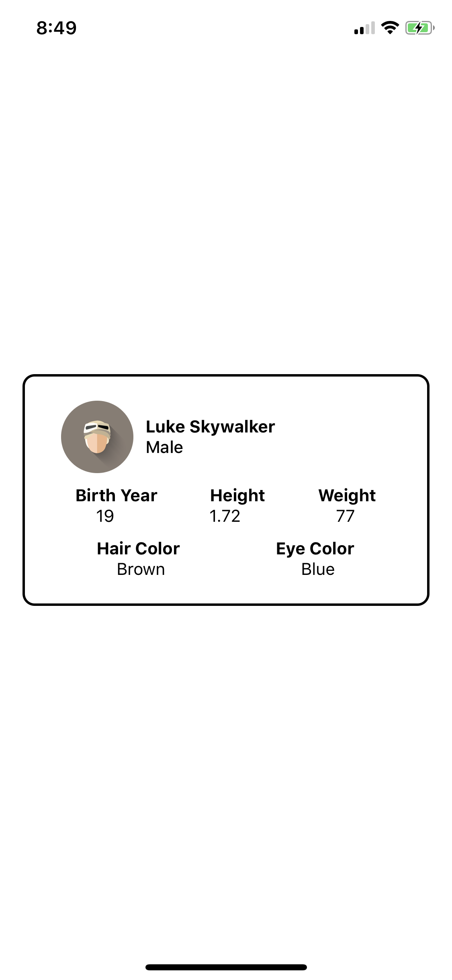
Live Demo
Jedi ID Card
Create an application that shows the following details about a Jedi:
Name
Gender
Birth Year
Height
Weight
Hair Color
Eye Color
Picture?
Notes:
Exercise: Make a layout for the screen.
Write code for UI in App.js (See https://github.com/stanford-cs47/Lecture2B-Final-Basic)

Slide 7
Design to Code
BEST PRACTICES
Break down the design
Choose a component for each part
Code the component tree and style it
USEFUL LINKS / React Native Docs / React Native Express / Cheatsheet

Slide 8
Overview for today
Live demo (throughout lecture)
Putting basic components to use
Styling layouts using Flexbox
Class Components
Props
State
Functional Components
Hooks

Slide 9
Overview for today
Live demo (throughout lecture)
Putting basic components to use.
Styling layouts using Flexbox.
Class Components
Props
State
Functional Components
Hooks
Notes:
New material! You saw examples of components on Tuesday (View, Text, etc.), but now you’ll learn how to make your own reusable components. Customized components are helpful when you find that you’re generating an item multiple times across your app (ex: a header). Two types of components: Class and Functional. We’ll talk about class components first.

Slide 10
Overview for today
Live demo (throughout lecture)
Putting basic components to use.
Styling layouts using Flexbox.
Class Components
Props
State
Functional Components
Hooks

Slide 11
Class Component
A Component that is declared using ES6 class syntax.

Slide 12
Class Component
A Component that is declared using ES6 class syntax.
import React from 'react'; import { StyleSheet, Text, View } from 'react-native'; export default class App extends React.Component {
render() { return ( <View style={styles.container}> <Text>Hello World!</Text> </View> ); } }
Notes:
What would happen if you wanted to change one small thing about this App component (ex: change the text or font size)? You don’t want to have to make an entirely new component just to allow for that one small change. We want these components to be reusable (that’s the whole point of making something into a component). If we have many instances of a component, how do we communicate to a particular instance that we want it to render a slightly different view from the others? Or what if we want an instance of a component to change once the user has done a particular action (i.e. clicking, typing, etc)? (Answer: Props and State)

Slide 13
How do I make my app respond to changes?
(e.g. a button click, network request fetch, etc.)
Notes:
How do I make my app interactive? (And how do you avoid rewriting code?) (Answer: Props and State)

Slide 14
Overview for today
Live demo (throughout lecture)
Putting basic components to use
Styling layouts using Flexbox
Class Components
Props
State
Functional Components
Hooks
Notes:
You’ll be using a component’s state and props to control what exactly shows up on the screen and when.

Slide 15
Overview for today
Live demo (throughout lecture)
Putting basic components to use
Styling layouts using Flexbox
Class Components
Props
State
Functional Components
Hooks

Slide 16
Props
The parameters passed to the constructor of a Component.
Notes:
Properties of a particular instance of the component.
Will get to what a constructor is in more detail later on, but for now, all you need to know is that it helps determine how to build a particular instance of a component (helps to plan how a component will render).

Slide 17
<Image
source={{uri: "https://facebook.github.io/react-native/docs/assets/favicon.png"}}
/>
Class Components
Props

Slide 18
<Image
source={{uri: "https://facebook.github.io/react-native/docs/assets/favicon.png"}}
/>
Class Components
Props
Notes:
Source is a parameter being passed as a prop of this particular Image instance.
Object value containing uri with value ...

Slide 19
<Image
source={{uri: "https://facebook.github.io/react-native/docs/assets/favicon.png"}}
/>
Class Components
Props
Notes:
Source has an object value containing uri with value ...
Note: [brackets] means to evaluate → necessary for reading javascript in HTML. Embed JS expression in JSX.

Slide 20
<Button onPress={onPressLearnMore} title="Learn More" color="#841584" accessibilityLabel="Learn more about this purple button" />
Class Components
Props
Notes:
Can you guess what properties are being passed to this Button instance? (Answer: See next slide)

Slide 21
<Button onPress={onPressLearnMore} title="Learn More" color="#841584" accessibilityLabel="Learn more about this purple button" />
Class Components
Props

Slide 22
Props
The parameters passed to the constructor of a Component.
Props are
only passed from
PARENT TO CHILD
Notes:
Explain parent child relationship (parent calls the child). See an example of this in next few slides.

Slide 23
Parent.
export default class Parent extends React.Component {
render() {
return (
<Image
source={{uri: "https://facebook.github.io/react-native/docs/assets/favicon.png"}}
/>
<Button onPress={onPressLearnMore} title="Learn More" color="#841584" accessibilityLabel="Learn more about this purple button" />
);
}
}
Class Components
Props
Notes:
Parent is creating an instance of Image with “source” property, and an instance of Button with “onPress,” “title,” “color,” and “accessibilityLabel” properties. These instances of Image and Button are children of this Parent component.
What do props look like on the child’s side? Recall the definition of props.

Slide 24
Props
The parameters passed to the constructor of a Component.
Props are
only passed from
PARENT TO CHILD

Slide 25
Child.
export default class Child extends React.Component {
constructor(props) { super(props);
// nothing has been rendered yet // you can change what is rendered based on the component’s props console.log(JSON.stringify(props));
}
}
Class Components
Props
Notes:
Defined constructor within Child.js.
Note: when accessing props within constructor, you only need to do “props” not “this.props”, but everywhere else it should be “this.props._____” assuming that “this” refers to the proper object.

Slide 26
Child -- Image.
export default class Image extends React.Component {
constructor(props) { super(props);
// Prints "https://facebook.github.io/react-native/docs/assets/favicon.png" console.log(JSON.stringify(props.source.uri));
}
}
Class Components
Props
Notes:
To access a particular prop, treat props as an object.
When a value in “props” changes, the component, in this case “Image”, is notified and re-renders.
How would you access each of the properties for the Button instance? (Extra exercise! Come to OH to discuss)

Slide 27
Overview for today
Live demo (throughout lecture)
Putting basic components to use
Styling layouts using Flexbox
Class Components
Props
State
Functional Components
Hooks

Slide 28
Overview for today
Live demo (throughout lecture)
Putting basic components to use
Styling layouts using Flexbox
Class Components
Props
State
Functional Components
Hooks

Slide 29
State
An object with details about how a Component should render.
This literally is an object named state

Slide 30
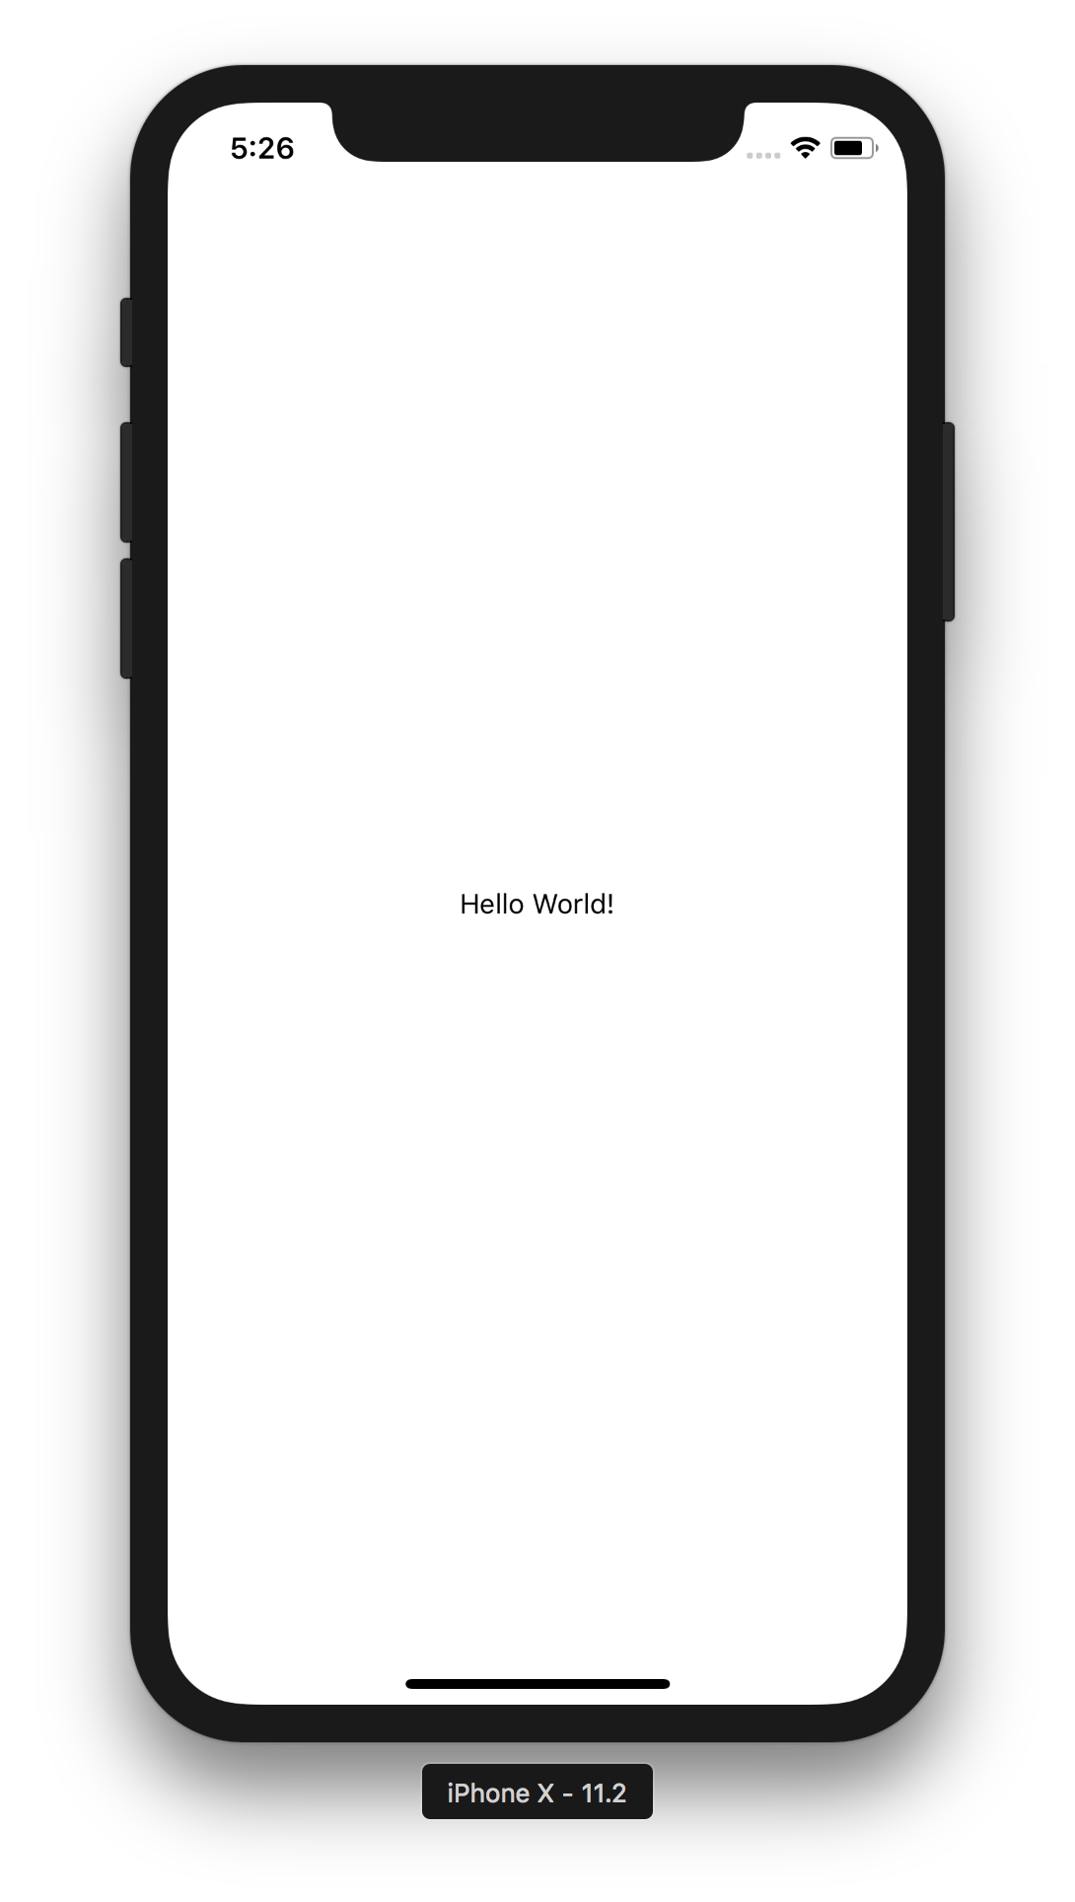
import React from 'react'; import { StyleSheet, Text, View } from 'react-native'; export default class App extends React.Component { render() { return ( <View style={styles.container}> <Text>Hello World!</Text> </View> ); } }
Notes:
Same code from when we defined a class component.
Start by defining the state object.

Slide 31
import React from 'react'; import { StyleSheet, Text, View } from 'react-native'; export default class App extends React.Component { state = { headline: 'Welcome to my app!' } render() { return ( <View style={styles.container}> <Text>Hello World!</Text> </View> ); } }
Notes:
Also common to declare state within constructor

Slide 32
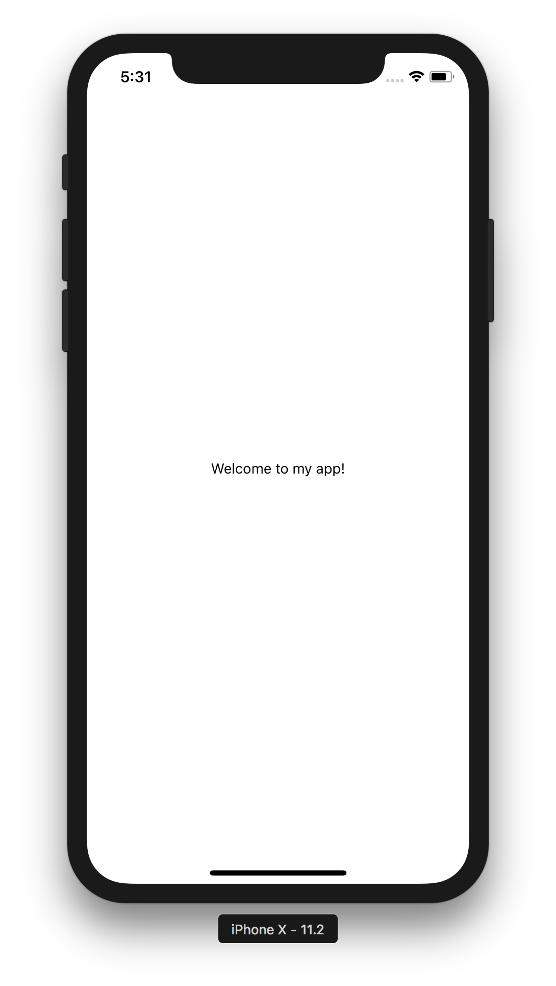
import React from 'react'; import { StyleSheet, Text, View } from 'react-native'; export default class App extends React.Component { state = { headline: 'Welcome to my app!' } render() { return ( <View style={styles.container}> <Text>{this.state.headline}</Text> </View> ); } }
Notes:
To access properties in the state do “this.state._____”

Slide 33
import React from 'react'; import { StyleSheet, Text, View } from 'react-native'; export default class App extends React.Component { state = { headline: 'Welcome to my app!' }
updateState = () => {
this.setState({ headline: ‘Welcome back to my app!’ });
} render() { ... } }
Notes:
To change the value of the state do “this.setState({ headline: newValue });”.
Similar to props, if the state changes, the component will detect the change and re-render.

Slide 34
this.state.x = y VS. this.setState({x:y})
Class Components
State
Notes:
https://stackoverflow.com/questions/37755997/why-cant-i-directly-modify-a-components-state-really

Slide 35
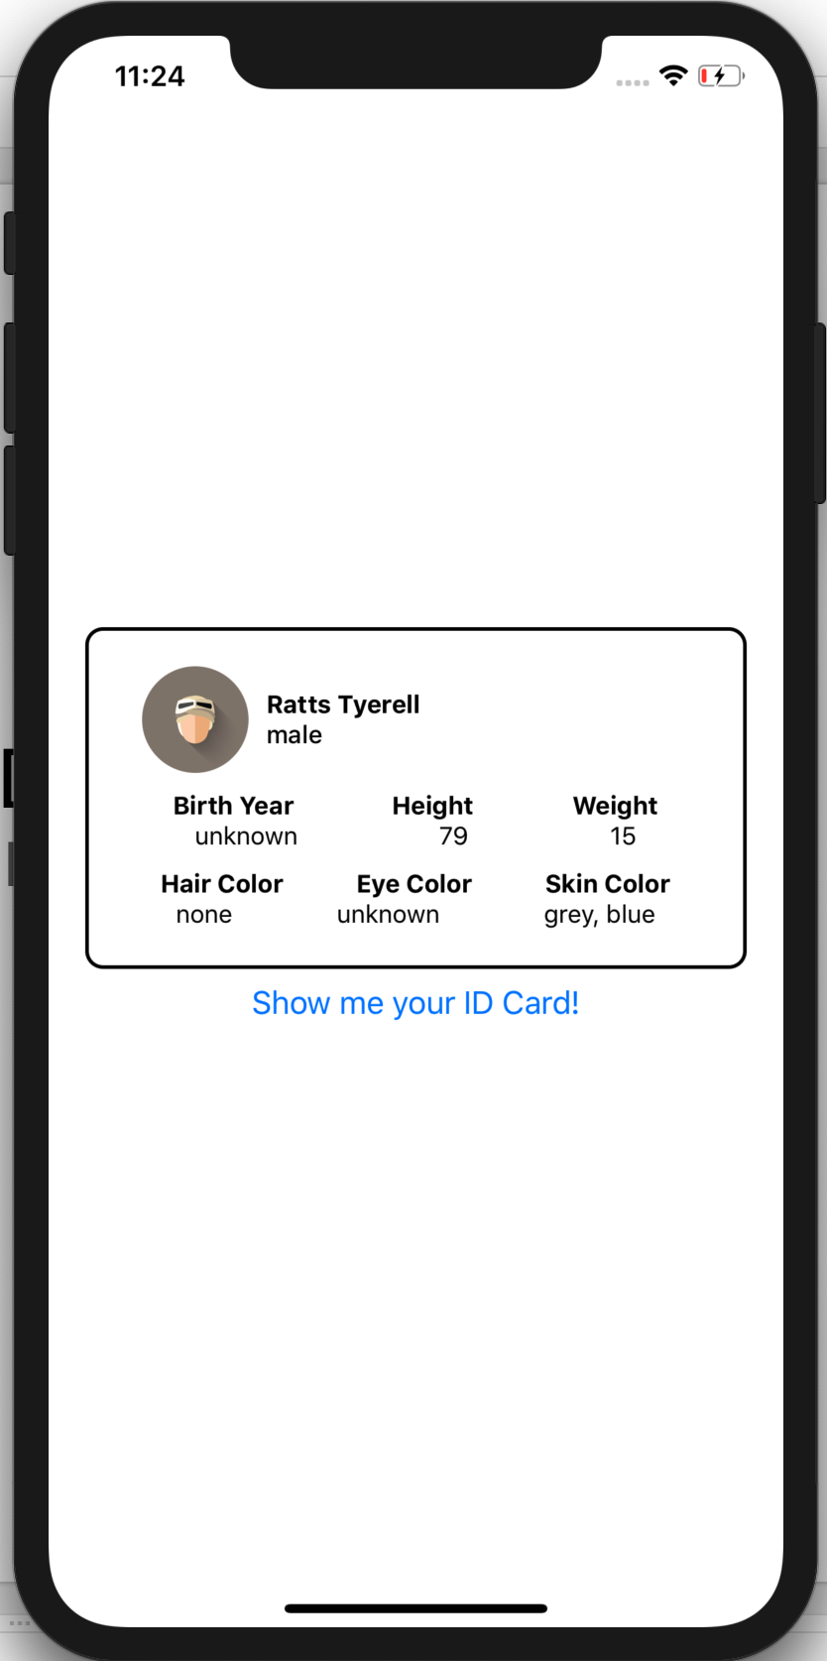
Live Demo
Jedi ID Card
Notes:
Creating StarWarsCard.js as a class component (See https://github.com/stanford-cs47/Lecture2B-Final-Class).

Slide 36
Overview for today
Live demo (throughout lecture)
Putting basic components to use
Styling layouts using Flexbox
Class Components
Props
State
Functional Components
Hooks
Notes:
Everything we just did can be done a second way, using another type of component: functional components.

Slide 37
Overview for today
Live demo (throughout lecture)
Putting basic components to use
Styling layouts using Flexbox
Class Components
Props
State
Functional Components
Hooks

Slide 38
Functional Component
A Component that is declared like a JS function.

Slide 39
Functional Component
A Component that is declared like a JS function.
const App = () => {
return ( <View style={styles.container}> <Text>Hello World!</Text> </View>
);
}

Slide 40
Functional Component
A Component that is declared like a JS function.
const App = (greeting) => {
return ( <View style={styles.container}> <Text>{greeting}</Text> </View>
);
}
Notes:
Since it is a function, you can pass in variables like you would to a normal function. This is equivalent to passing a prop into a class component.
What if we wanted to make a functional component interactive too? Until recently, we weren’t able to because there was no state in functional components. Then, React introduced a way to apply the state feature to functional components.

Slide 41
Functional Component
A Component that is declared like a JS function.
const App = (greeting) => {
return ( <View style={styles.container}> <Text>{greeting}</Text> </View>
);
}
Notes:
Creating StarWarsCard.js as a functional component (Move code for UI into functional component).
You don’t want to go to the parent every single time you need a child component’s data changes. How do you detect changes to a component’s data through that component itself? (Answer: Class components)

Slide 42
Overview for today
Live demo (throughout lecture)
Putting basic components to use
Styling layouts using Flexbox
Class Components
Props
State
Functional Components
Hooks

Slide 43
Overview for today
Live demo (throughout lecture)
Putting basic components to use
Styling layouts using Flexbox
Class Components
Props
State
Functional Components
Hooks

Slide 44
Hooks
Functions that allow you to “hook into” React state and life cycle features from function components.
Notes:
We’ll talk about component life cycles later in the course.

Slide 45
Hooks
Functions that allow you to “hook into” React state and life cycle features from function components.
Two Rules of Hooks
1) Only call Hooks at the top level
2) Only call Hooks from React
functional components
Notes:
Only call Hooks at the top level. Don’t call Hooks inside loops, conditions, or nested functions.
Only call Hooks from React function components. Don’t call Hooks from regular JavaScript functions.
There are a few built-in hooks already provided by React, but for now we will just look at one: useState.

Slide 46
state object
(Class Components)
useState Hook
(Functional Components)
const [x, setX] = useState(z)
setX(y)
import { useState } from 'react';
state = { x: z }
this.setState({ x: y })
Functional Components
Hooks
Notes:
We already know about the state object that we can use with class components, and the useState Hook is basically the same idea, but with functional components.
Array destructuring.

Slide 47
Creating Your Own Hooks
JS function whose name starts with “use” (ex: useX) and may call other Hooks.
These allow functional components to “subscribe” to specific information.
I really want to know if Emily is online
Emily’s online status
SUBSCRIBE
I also want to know if Emily is online

Slide 48
How would you change the code for our Jedi ID Card to use functional components and the useState Hook (instead of
class components and props/state)?
(We’ll leave this as a highly recommended exercise,
but the solution can be found here.)
USEFUL LINKS / React Hooks

Slide 49
Office Hours
Email us directly if you’re not available at these times
Abdallah AbuHashem
Monday (12-1 PM) @ Huang Basement
By appointment
Vy Mai
Tuesday (3-4 PM) @ Old Union
By appointment
Cisco Vlahakis
Wednesday (8-9 PM) @ Huang Basement
By appointment
Tiffany Manuel
Thursday (2-3 PM) @ Huang Basement
By appointment

Slide 50
CS47: Cross-Platform Mobile Development
Lecture 2B: Components, Props + State, Hooks
James Landay
Abdallah AbuHashem
Tiffany Manuel
Cisco Vlahakis
Vy Mai
Fall 2019
https://cs-47.stanford.edu
cs47-fall19.slack.com

